Slide 1
FITTING A GAUSSIAN

Slide 2
FITTING A LINE

Slide 3
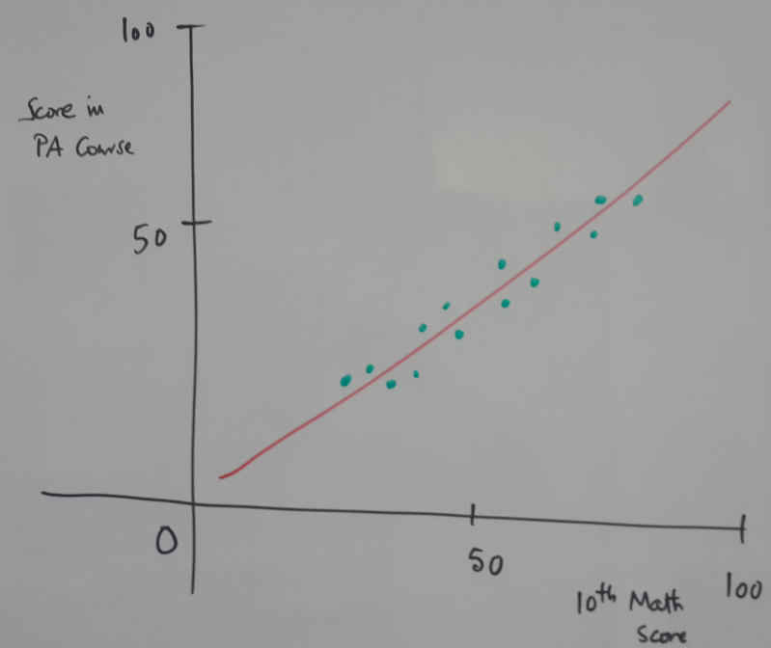
Fitting a straight line
Score
In ML course
$$Data:\{x_{i},y_{i}\}_{i=1:N}$$
$$Model:ypred=a+b*x$$
$$Loss:J(a,b)=∑(y_{i}-ypred_{i})^{2}$$
10th math
course

Slide 4
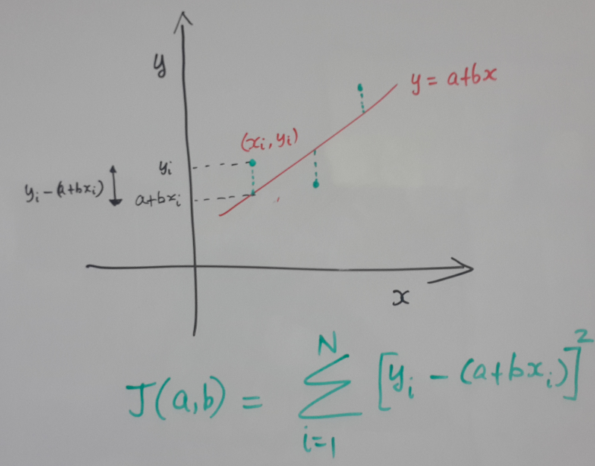
Fitting a straight line – Cost function

Slide 5
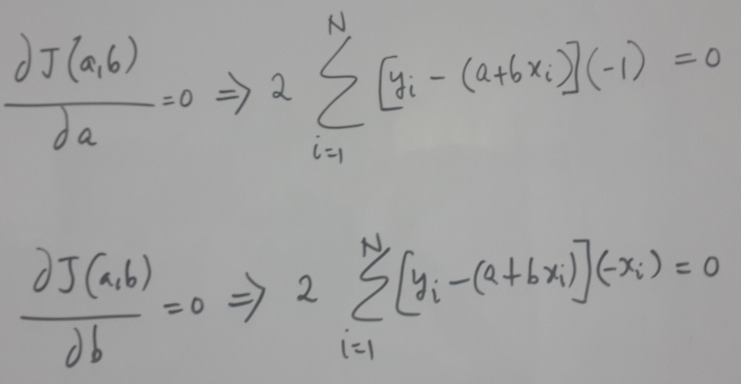
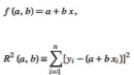
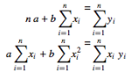
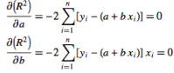
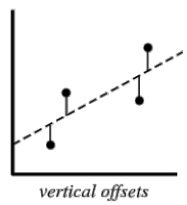
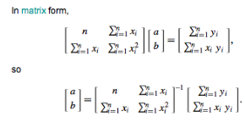
Closed form – Minimize sum of square error

Slide 6
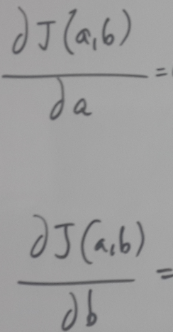
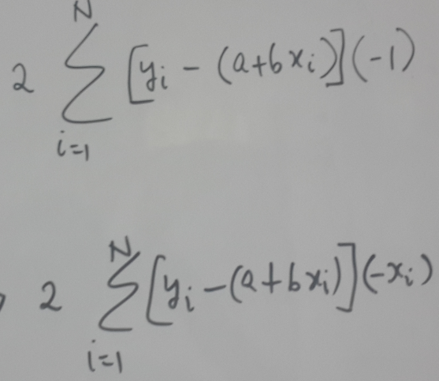
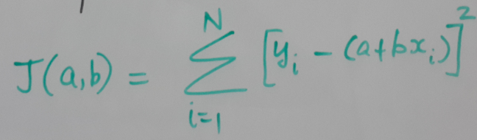
Gradient Descent – Minimize sum of square error
Notes:
Here again we compute the gradient. Then update
b as follows:
a as follows:
mu is parameter that needs to be chosen at the beginning
of our procedure.

Slide 7
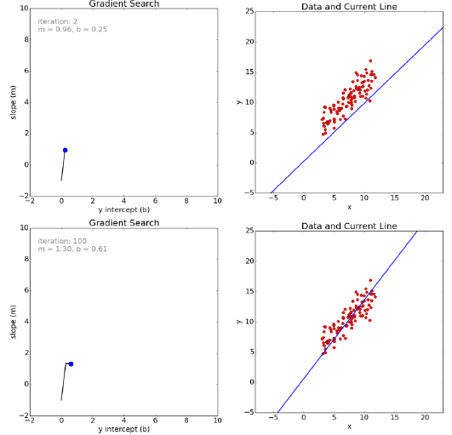
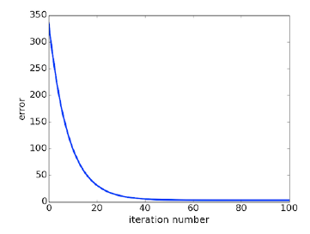
Slope
Score
In ML course
Convergence: loss function
10th math
course
Intercept
Slope
Intercept

Slide 8
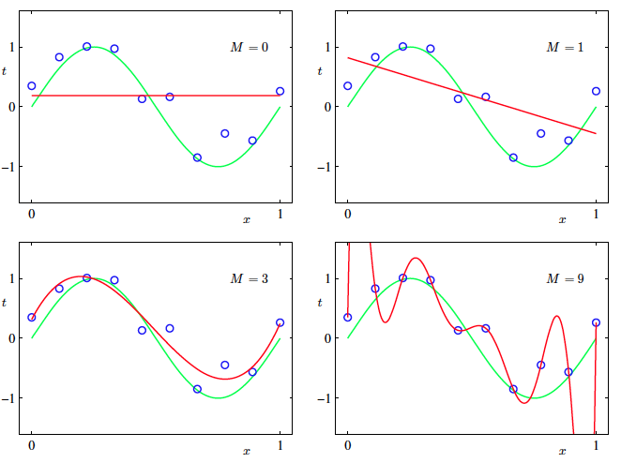
Regularization: Overfitting
Are linear
models enough?
NO..

Slide 9
Tasks
 | Output = continuous | Output = discrete
Supervised | Regression | Classification
Unsupervised | Dimensionality reduction | Clustering
Solutions
Hierarchical,
Non-linear Model
Deep NN
SVR/SVM,
NN
Non-linear Model
Linear Model

Slide 10
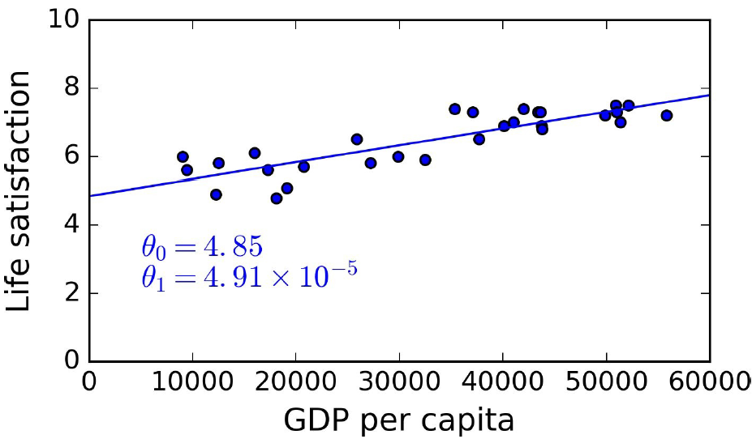
FAQs
Why solve “fitting a line” problem?
Helps convey ML terminology
Surprisingly, more complex models can be motivated and understood using linear models

Slide 11
FAQs
Why use squared error?
Losses ideally should be a smooth function..
Apart from that, square error is equivalent to a Maximum Likelihood approach [exact details we will come to later]

Slide 12
Regression task
$$Data:\{x_{i},y_{i}\}_{i=1:N}$$
$$Model:ypred=a+b*x$$
Linear Model
$$Loss:J(a,b)=∑(y_{i}-ypred_{i})^{2}$$
y
y
ypred_{i}
ypred_{i}
y_{i}
y_{i}
x
x
x_{i}
x_{i}
Notes:
As regards the regression problem,
m and c are the parameters of the model i.e. decides a straight line,
and given two possible straight lines the one that leads to the
Least squared error is what we will choose..
Compared to the line on the left, the right line leads to
Smaller sum of squared error corresponding to the expression shown..

Slide 13
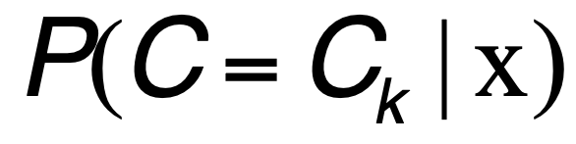
Probabilistic classifiers
Probabilistic classifiers estimate
Given x the features, we want to estimate the probability that the class label C is say
C₁(i.e. MALE) or C₂(i.e. FEMALE)

Slide 14
Solution 1: Classification problem
MODEL, LEARNING, INFERENCE ALGORITHM
e.g. Spam detection problem
Models: straight line to divide (a linear model)
Past Emails
Answers: Spam or not
Learning
Algorithm
x₂
x₂
x₁
x₁
Notes:
Now let us make this less abstract with examples..
One possible model for the classification problem
Is a straight line separator to divide the different
Classes.
Couple of learning algorithms are perceptron and
Support Vector Machines (SVM)..The learning
Algorithm learns the parameters of the st. line
i.E slope and the intercept.
Given a new point see which side of the line the
Point belongs to and then decide the class label..

Slide 15
Deterministic vs probabilistic classifiers
Output
MALE/FEMALE, C
Output
P(MALE|x), P(FEMALE|x)
ML
Algo
ML
Algo
random
variable
Input
Hair length, x
Input
X

Slide 16
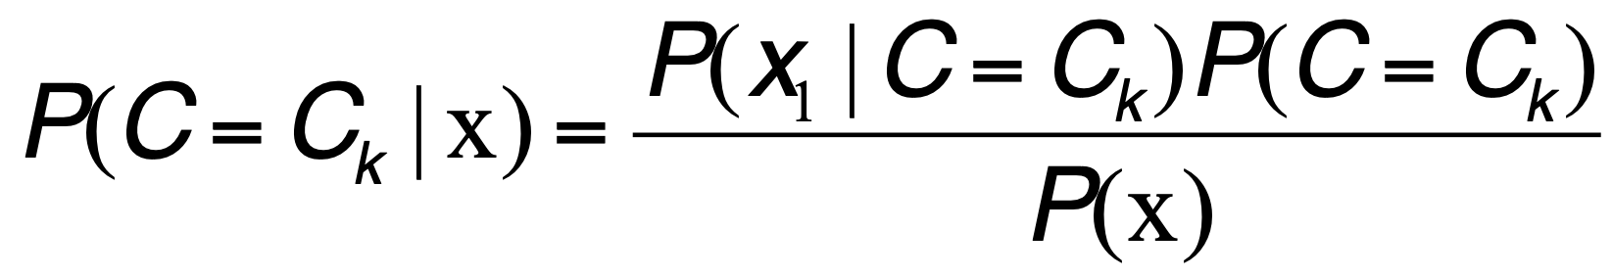
Bayes classifier
Probabilistic classifiers estimate
Given x the features, we want to estimate the probability that the class label C is say
C₁(i.e. MALE) or C₂(i.e. FEMALE)
Use Bayes theorem, assuming 1-D feature vector
x₁ is continuous

Slide 17
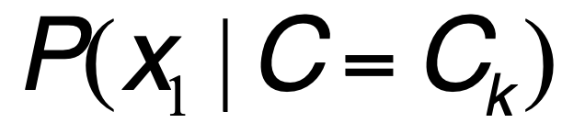
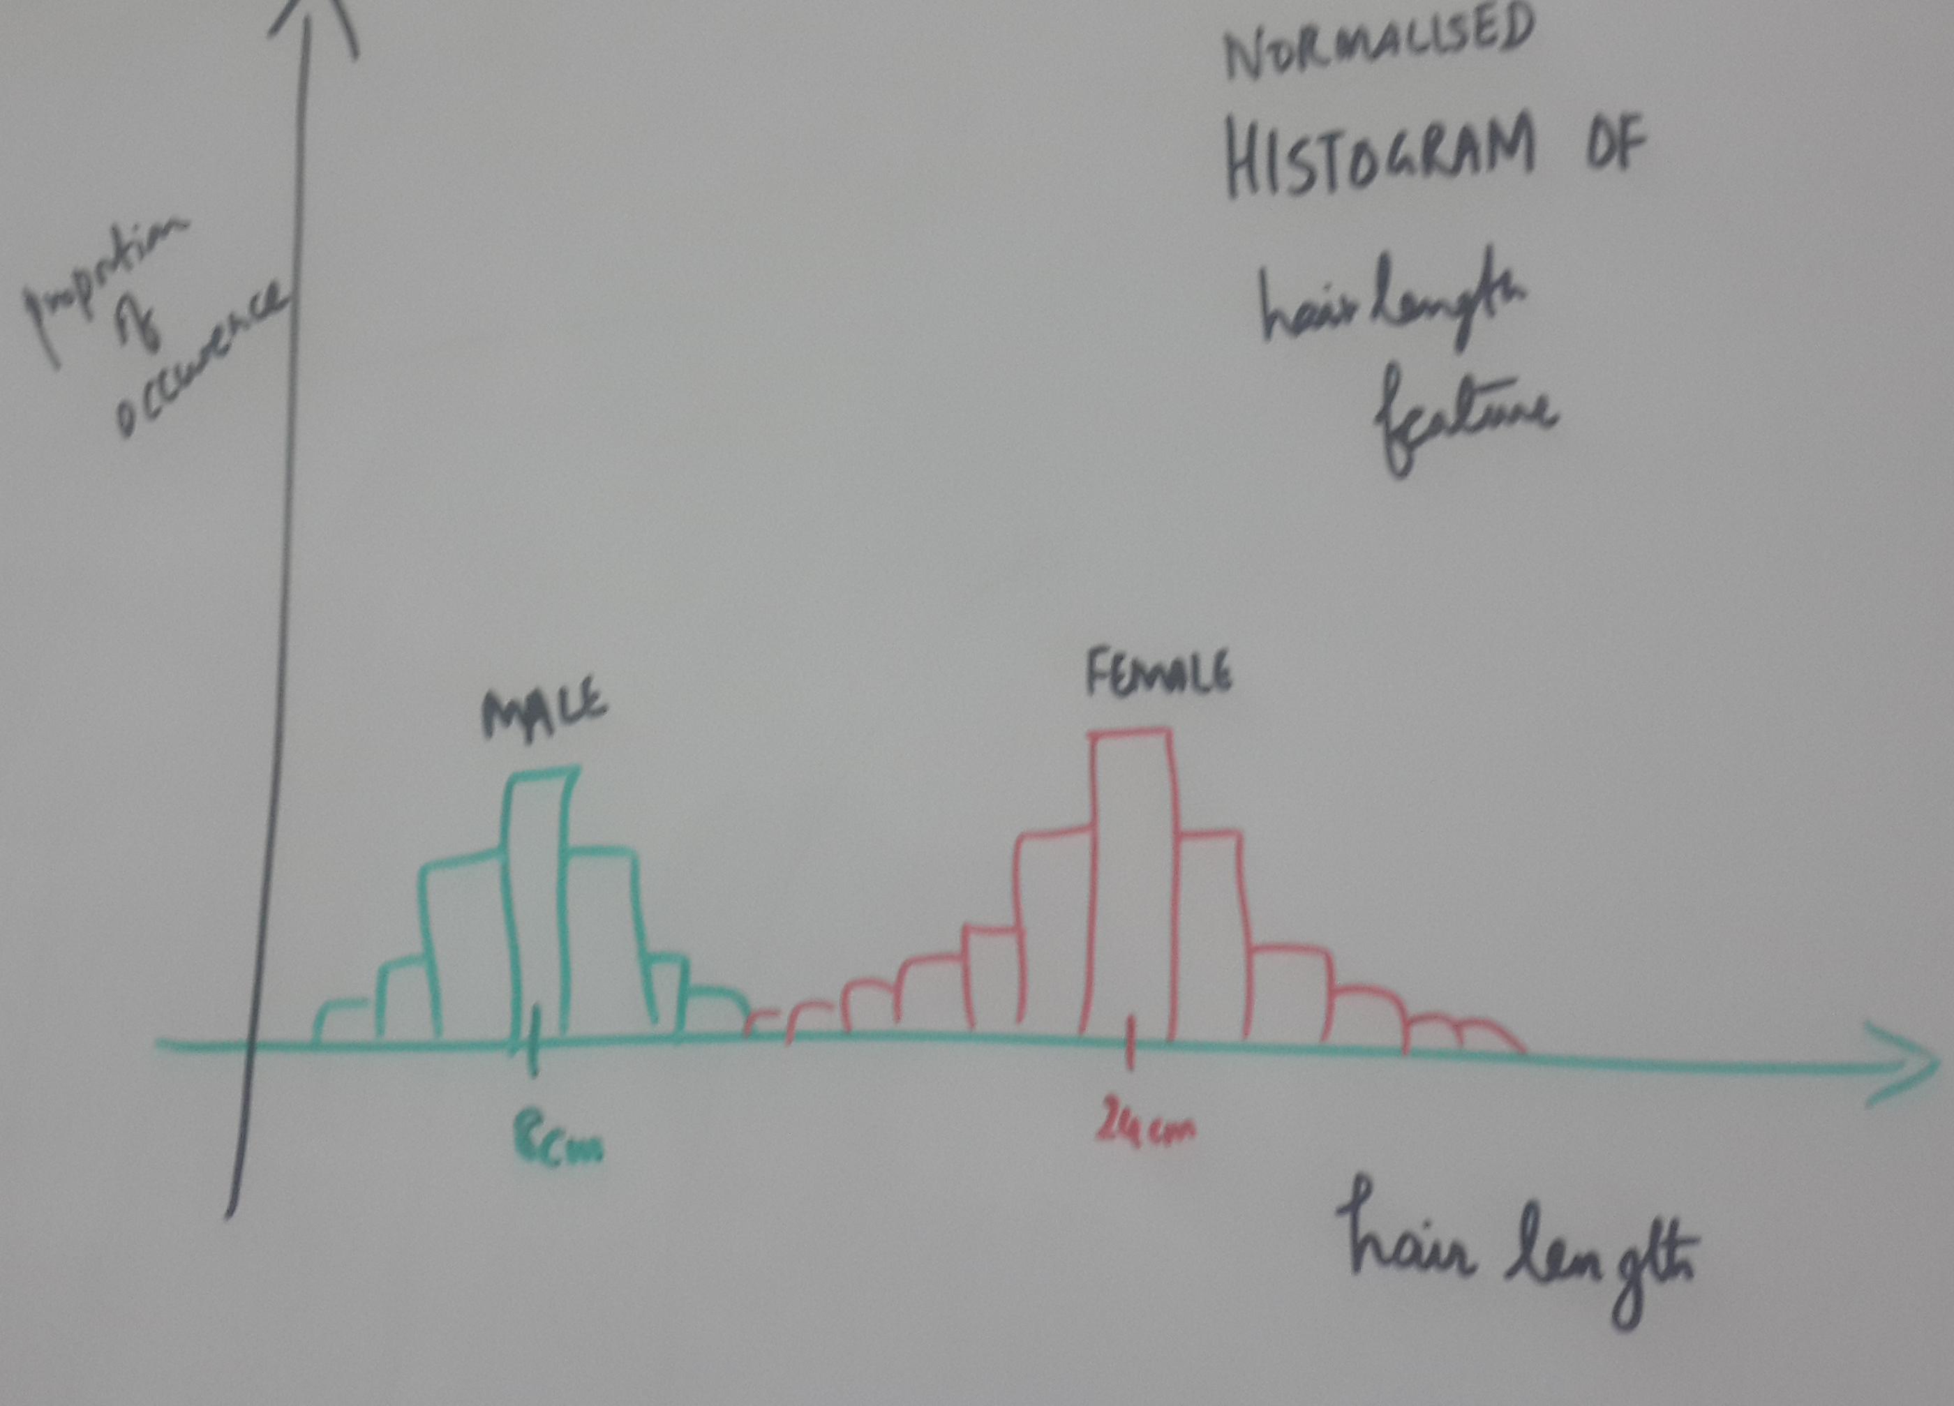
Normalized Histogram
To start with we can bin the continuous values and observe the histogram (after normalizing i.e. the elements sum up to 1)

Slide 18
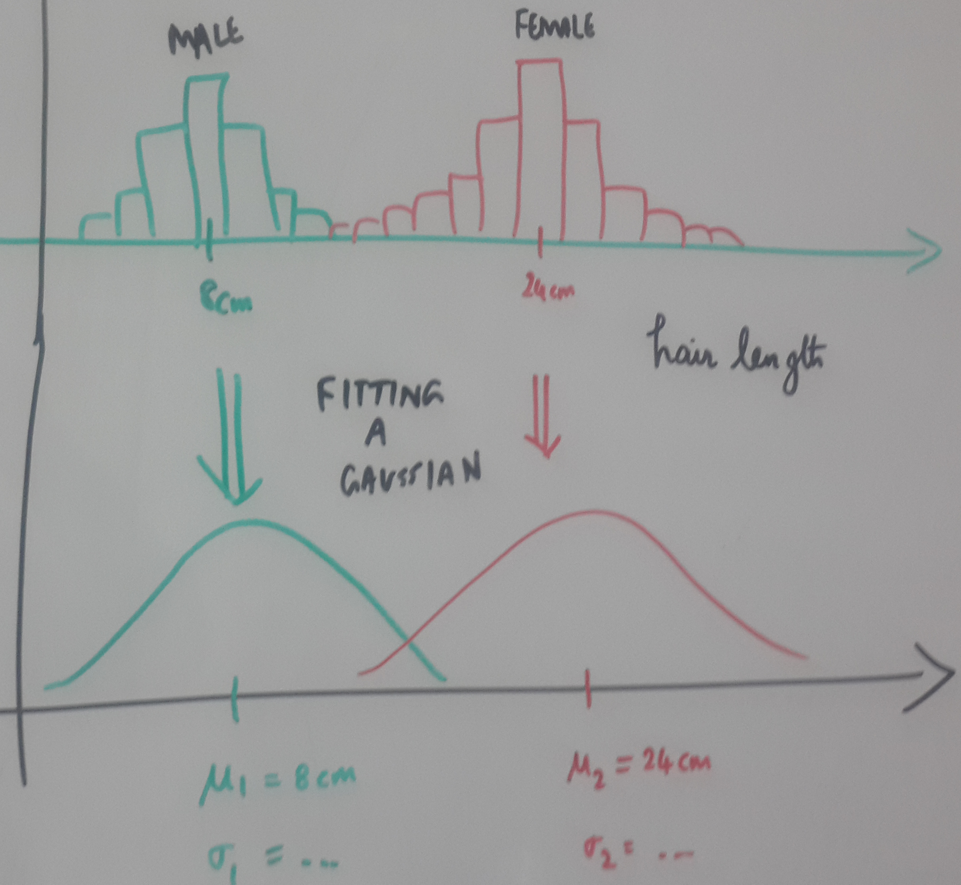
Fitting a Gaussian distribution
Makes sense to keep only two parameters mu and sigma of the Gaussian distribution and throw away the original data
Question: How to estimate mu and sigma?

Slide 19
FITTING A GAUSSIAN

Slide 20
Regression task
$$Data:\{x_{i},y_{i}\}_{i=1:N}$$
$$Model:ypred=a+b*x$$
Linear Model
$$Loss:J(a,b)=∑(y_{i}-ypred_{i})^{2}$$
y
y
ypred_{i}
ypred_{i}
y_{i}
y_{i}
x
x
x_{i}
x_{i}
Notes:
As regards the regression problem,
m and c are the parameters of the model i.e. decides a straight line,
and given two possible straight lines the one that leads to the
Least squared error is what we will choose..
Compared to the line on the left, the right line leads to
Smaller sum of squared error corresponding to the expression shown..

Slide 21
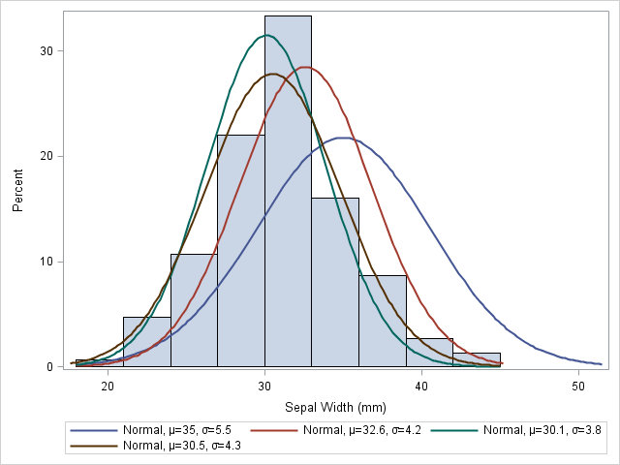
DENSITY ESTIMATION TASK:
Which Gaussian is the best?
Data
$$\{x_{i}\}_{i=1:N}$$
Model
$$p(x_{i}|μ,σ)=\frac{1}{σ\sqrt{2π}}e^{\frac{-(x_{i}-μ)^{2}}{2σ^{2}}}$$
Hair length
of women

Slide 22
Maximum likelihood function
Let us define a cost function in terms of the parameters to be estimated
We should find that value of parameter which maximizes the probability of observing the given N samples
$$p(X|θ)=p(x_{1}x_{2}..x_{N}|θ)$$

Slide 23
Maximum likelihood
$$p(X|θ)=p(x_{1}x_{2}..x_{N}|θ)$$
Definition
$$p(X|θ)=\overset{N}{\underset{i=1}{∏}}p(x_{i}|θ)$$
Assuming the samples are independently drawn
Take logarithm (makes our life easier for further steps; as it is a monotonic function, we are allowed to do so)
Independent samples assumption
$$l(θ)=ln(p(X|θ)=Σ_{i=1}^{N}ln(p(x_{i}|θ))$$
Take log
$$\overset{̂}{θ}=argmax_{θ}(l(θ))$$
Cost function: Maximise log-likelihood

Slide 24
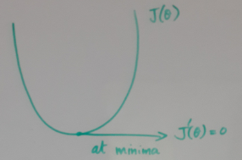
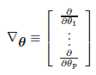
Maximum likelihood (closed form)
$$p(X|θ)=p(x_{1}x_{2}..x_{N}|θ)$$
$$p(X|θ)=\overset{N}{\underset{i=1}{∏}}p(x_{i}|θ)$$
$$l(θ)=ln(p(X|θ)=Σ_{i=1}^{N}ln(p(x_{i}|θ))$$
$$\overset{̂}{θ}=argmax_{θ}(l(θ))$$
at maxima also
$$∇_{θ}l=Σ_{i=1}^{N}∇_{θ}ln(p(x_{i}|θ))=0$$

Slide 25
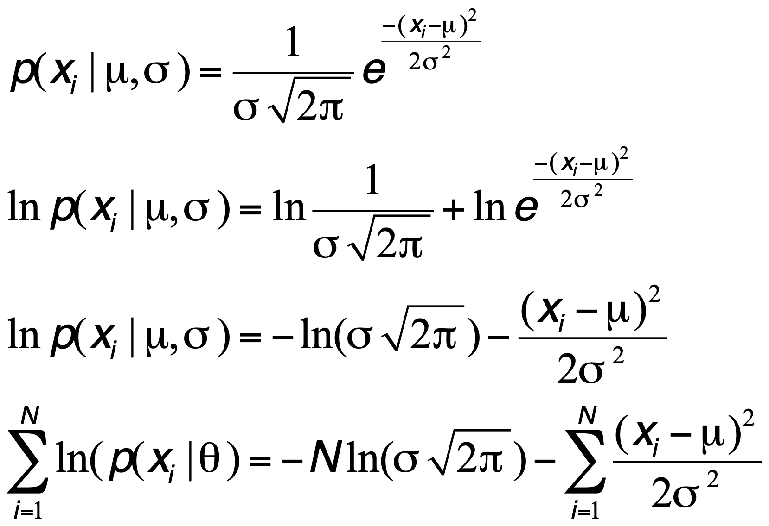
ML – single dimensional Gaussian

Slide 26
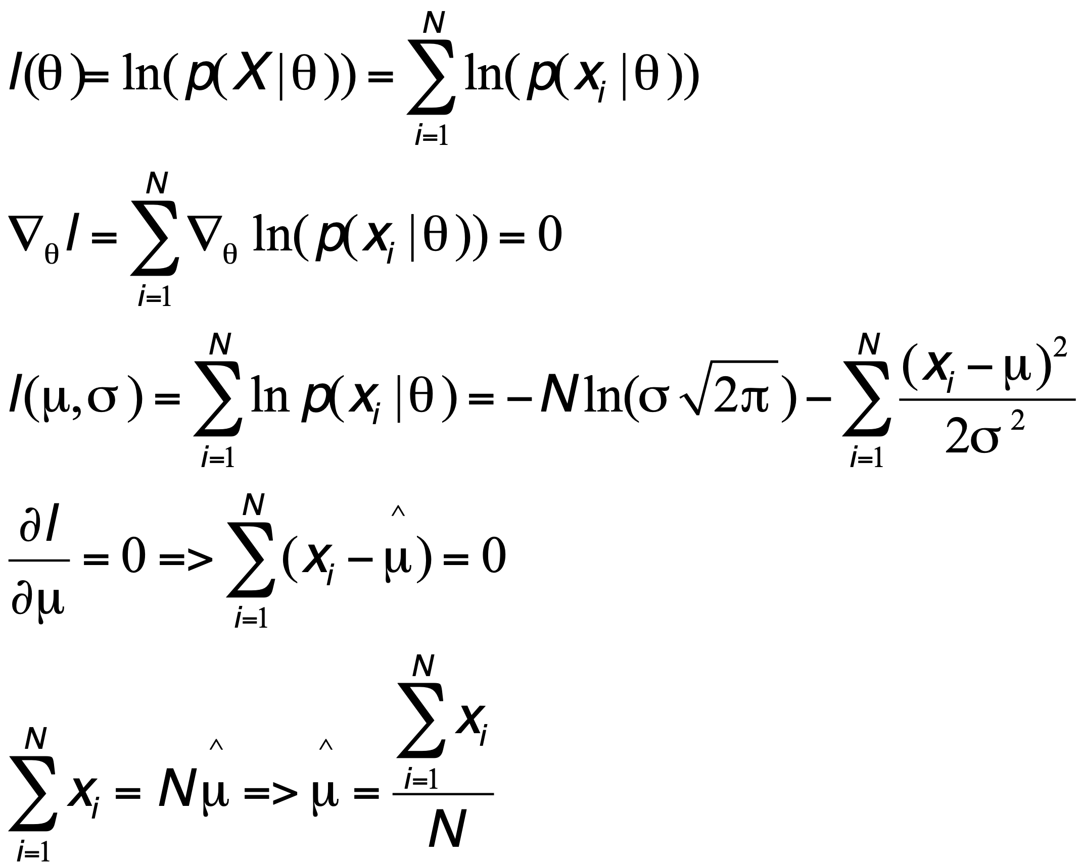
ML – single dimensional Gaussian

Slide 27
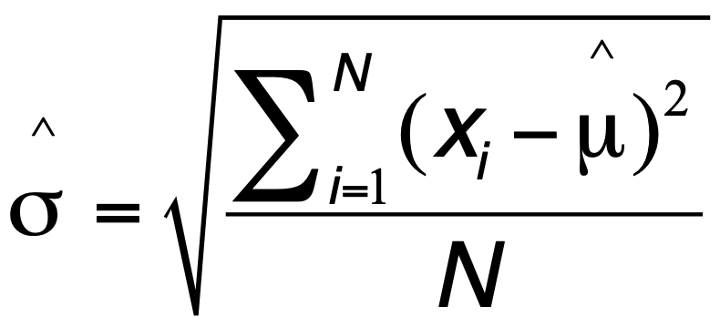
ML – single dimensional Gaussian
Home work

Slide 28
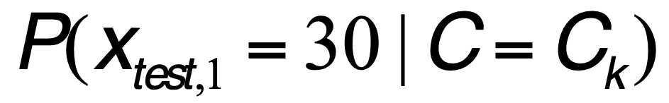
Inference Algorithm
0.25
25%

Slide 29
Bayes classifier

Slide 30
Naïve Bayes classifier
Probabilistic classifiers estimate
Use Bayes theorem
Use Naïve assumption, given class label the features are independent (class conditional independence)
$$P(C=C_{k}|x)$$
$$P(C=C_{k}|x)=\frac{p(x_{1}x_{2}|C=C_{k})P(C=C_{k})}{p(x)}$$
$$P(C=C_{k}|x)=\frac{p(x_{1}|C=C_{k})p(x_{2}|C=C_{k})P(C=C_{k})}{p(x)}$$

Slide 31
Bayes classifier
Probabilistic classifiers estimate
Given the 2D features, we want to estimate the probability that the class label C is say
C₁(i.e. MALE) or C₂(i.e. FEMALE)
Use Bayes theorem, assuming 2D feature vector
$$P(C=C_{k}|x)$$
$$P(C=C_{k}|x)=\frac{p(x_{1}x_{2}|C=C_{k})P(C=C_{k})}{p(x)}$$

